Slide 1

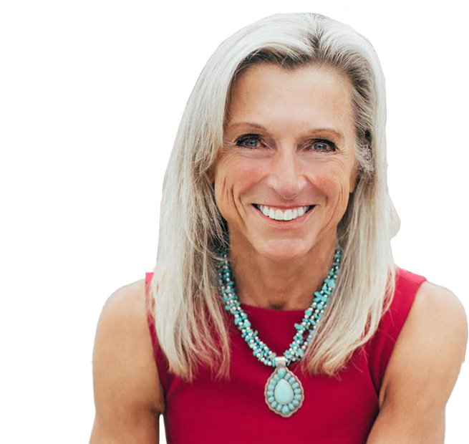


Weekly Strategy Perspectives
Witch Bubble Hunting
Carol Schleif,
Chief Market Strategist
BMO Private Wealth

